Slide 1
DEADLOCKS

Slide 2

About the Author
Created By: | Sucharita Das (241163) & Rajalaxmi (301159)
Credential Information: | 8+ years of SQL Server developer/architect experience
Version and Date: | SS2008/0611/1.0
Cognizant Certified Official Curriculum

Slide 3









Icons Used
Hands on Exercise
Questions
Tools
Coding Standards
Test Your Understanding
Reference
A Welcome Break
Contacts
Demonstration

Slide 4
Overview
How blocking leads to deadlocks?
What is a deadlock?
What happens then?
Capturing deadlocks
Resources that may cause it
Minimizing deadlocks

Slide 5
Deadlocks: Objective
Objective:
After completing this chapter you will be able to:
Know the effects of Deadlocks
How to identify and prevent them

Slide 6
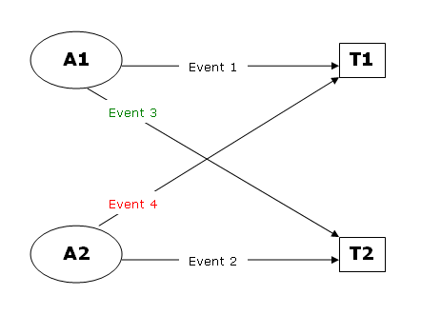
Blocking - Deadlocks
Blocking escalates to a bigger problem – DEADLOCKS

Slide 7
Deadlock
A deadlock occurs when two or more tasks permanently block each other by each task having a lock on a resource which the other tasks are trying to lock

Slide 8
What happens then?
SQL Server chooses one of the processes as the deadlock victim and aborts it.
It is rolled back and a 1205 error notification is sent back to the user.
Your server command (process id N) was deadlocked with another process and has been chosen as deadlock victim. Re-run your command.
This process is taken care by the LOCK MONITOR

Slide 9
Choosing the deadlock victim
Deadlock priority – lowest priority process chosen as the victim
SET DEADLOCK_PRIORITY { LOW | NORMAL | HIGH | <numeric-priority> | @deadlock_var | @deadlock_intvar } <numeric-priority> ::= { -10 | -9 | -8 | … | 0 | … | 8 | 9 | 10 }
Rollback cost
– in case of equal priority, this is taken into consideration
- the process with the lowest rollback cost is chosen.

Slide 10
Resources that can cause Deadlock
Locks
Worker Threads
Memory

Slide 11
Deadlock Detection
Default interval time (5 secs) reduced to 100ms by the database engine in the event of occurrence of a deadlock
Resolving done by choosing the deadlock victim and raising the exception
Resources are then to be EXPLICITLY released.

Slide 12
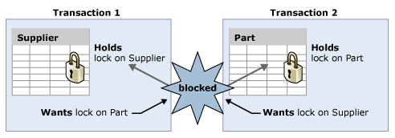
An Example..

Slide 13
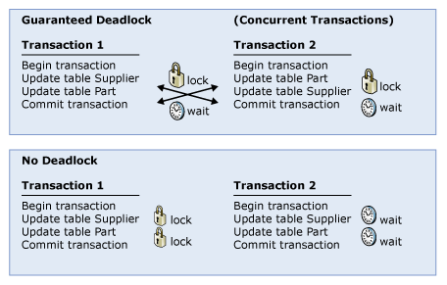
Minimizing Deadlocks (1)
Access objects in the same order.

Slide 14
Minimizing Deadlocks (2)
Avoid user interaction
Keep transactions short and in one batch.
Use a lower isolation level.
Use a row versioning-based isolation level.
-Set READ_COMMITTED_SNAPSHOT ON to enable read-committed transactions to use row versioning.
-Use snapshot isolation.
Use bound connections.

Slide 15
Capturing Deadlocks
Deadlock Graphs - an output of information regarding the sessions and resources that were involved in a deadlock.
Ways:
- Trace flags
- Trace Profiler

Slide 16
Capturing Deadlocks(2)
Trace flags
Flag 1204(SS 2000)
Flag 1222(SS 2005)
- outputs the deadlock graph info into the error log.
- makes it easier to analyse the deadlock
Set ON by
DBCC TRACEON(1204,-1)
Properties->General->Startup settings ->T-1222
- outputs the deadlock graph info into the error log.
- makes it easier to analyse the deadlock

Slide 17
Capturing Deadlocks(3)
SQL Profiler
Select the deadlock graph event under the Locks events
Info saved as an xdl file.
Can also export script and access the deadlocks on the server side via:
SP_TRACE_*

Slide 18
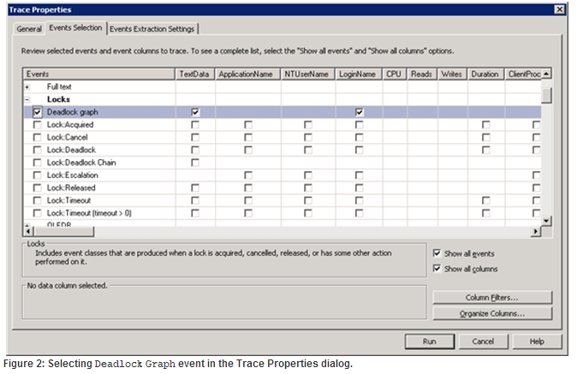
Profiler: Event Selection

Slide 19
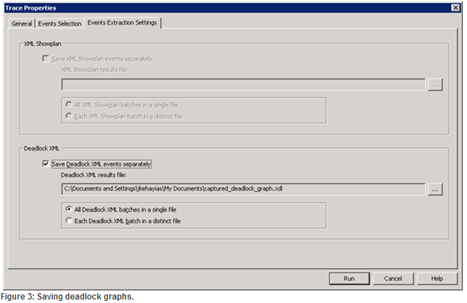
Profiler: Extraction Settings

Slide 20
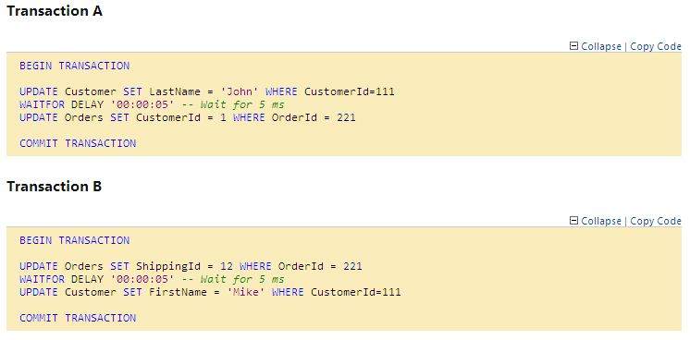
Example ..

Slide 21

Example: Output

Slide 22
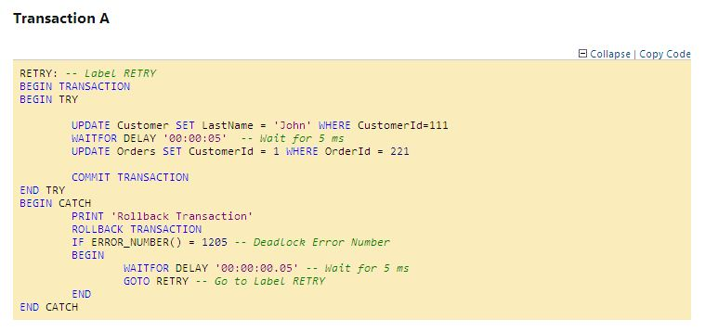
Dealing with Deadlock problem(1)

Slide 23
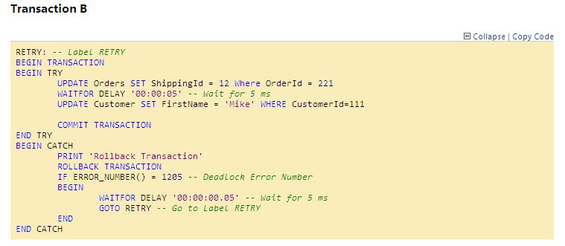
Dealing with Deadlock problem(2)

Slide 24
Test your understanding
What are deadlocks?
List some ways to avoid the possibility of encountering deadlocks
What is the use of flags with respect to deadlock detection?

Slide 25
Deadlocks: Summary
Deadlocks are problems caused by interdependent processes trying to access the resources acquired by each other.
Avoided by effective and efficient coding mechanisms
Captured via:
Deadlock graphs
Trace flags
Profiler

Slide 26
Deadlocks: Sources
http://msdn.microsoft.com/en-us/library/ms188246.aspx
http://www.simple-talk.com/sql/database-administration/handling-deadlocks-in-sql-server/
http://www.codeproject.com/Articles/42547/SQL-SERVER-How-To-Handle-Deadlock

Slide 27

You have successfully completed SQL Server – Deadlocks Concepts

